Slide 1
Lines and Angles
Adjacent, Vertical, Complimentary and Supplementary Angles

Slide 2
Video
https://www.youtube.com/watch?v=GO20ZgUzlc0

Slide 3
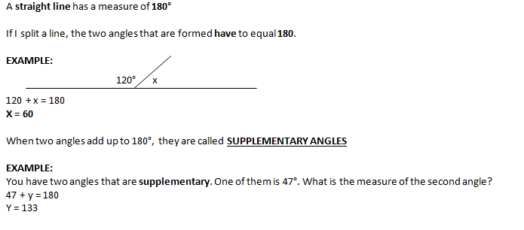
Supplementary Angles

Slide 4
Supplementary Practice

Slide 5
Summary
Find the supplementary angles.

Slide 6
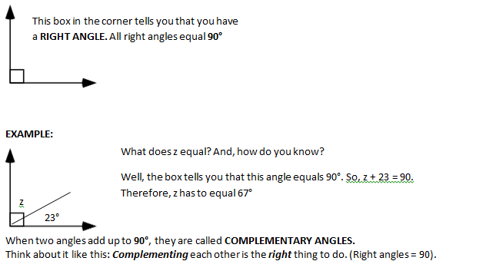
Complimentary Angles

Slide 7
Complimentary Practice

Slide 8
Summary
Find the Complement.

Slide 9
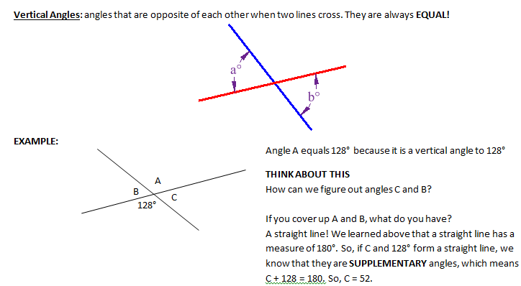
Vertical Angles

Slide 10
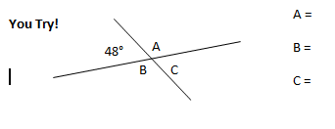
Vertical Practice

Slide 11
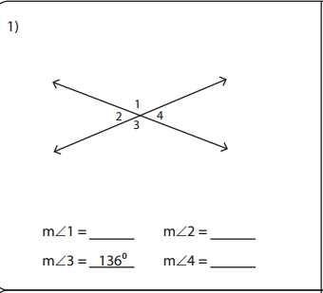
Summary

Slide 12
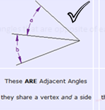
Adjacent Angles

Slide 13
Adjacent Angles
96
2x
48
180= 2x + 96 + 48
180= 2x+144
180= 2x+144
-144 -144
36=2x
2 2
18=x

Slide 14
Adjacent Angles
Solve for x
75
3x
42

Slide 15
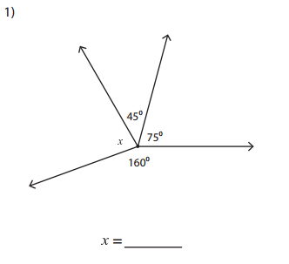
Summary

Slide 16
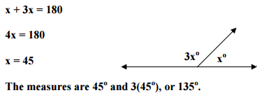
Solving equations with supplementary angles

Slide 17
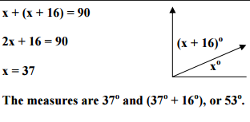
Solving equations with complementary angles

Slide 18
Solving equations with supplementary angles
1.) Solve for x
2.) What are the measures of the two angles?

Slide 19
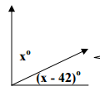
Solving equations with complementary angles
1.) Solve for x
2.) What are the measures of the two angles?

Slide 20
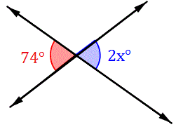
Solving equations with vertical angles
74 = 2x
2 2
37 = x

Slide 21
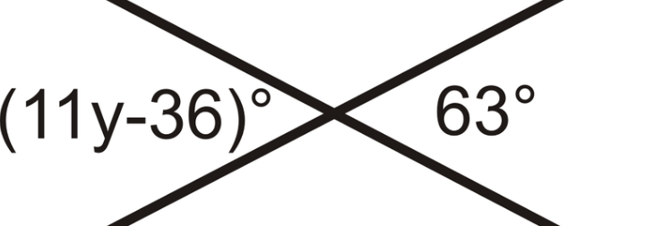
Solving equations with vertical angles
Solve for y:

Slide 22
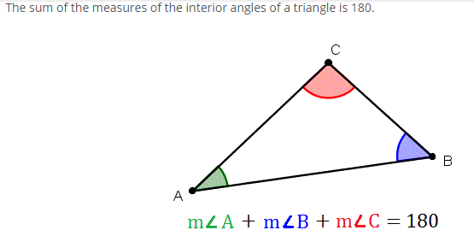
Triangle Angle Theorem

Slide 23
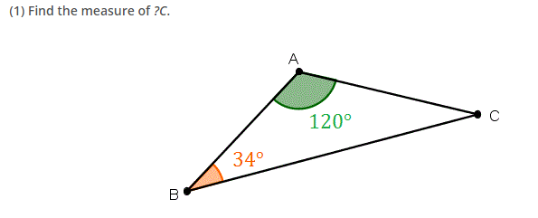
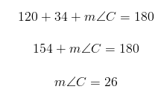
Triangle Angle Theorem

Slide 24
Triangle Angle Theorem

